Slide 1

6th Grade Math
Unit 5, Lesson 8 Determining Distances Volume 1, pg. 246

Slide 2


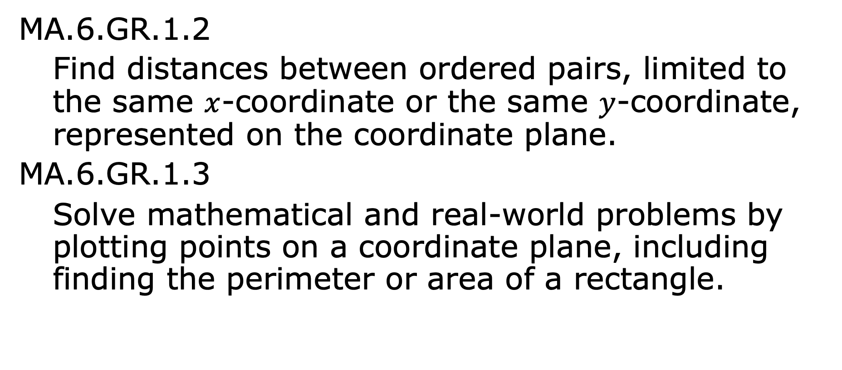
Benchmarks
MA.6.GR.1.2
Find distances between ordered pairs, limited to the same $x$-coordinate or the same $y$-coordinate, represented on the coordinate plane.
MA.6.GR.1.3
Solve mathematical and real-world problems by plotting points on a coordinate plane, including finding the perimeter or area of a rectangle.
volume 1, pg. 246

Slide 3
Integrated Mathematical Thinking and Reasoning Standards
MA.K12.MTR.1.1 Actively participate in effortful learning both individually and collectively.
MA.K12.MTR.4.1 Engage in discussions that reflect on the mathematical thinking of self and others.
MA.K12.MTR.7.1 Apply mathematics to real-world contexts.
volume 1, pg. 246

Slide 4

Learning Targets
I can find distances between ordered pairs.
I can solve a problem by plotting points on a coordinate plane and determining distances.
volume 1, pg. 246

Slide 5

Warm-Up
volume 1, pg. 247

Slide 6
5.8.1 Warm-Up: Superpowers
If you could have a superpower, what would it be and why?
Think of a superhero whose powers relate to mathematics.
Which superhero do you have in mind?
Explain how his or her superpowers relate to mathematics.
volume 1, pg. 247

Slide 7

Guided Instruction
volume 1, pg. 247

Slide 8
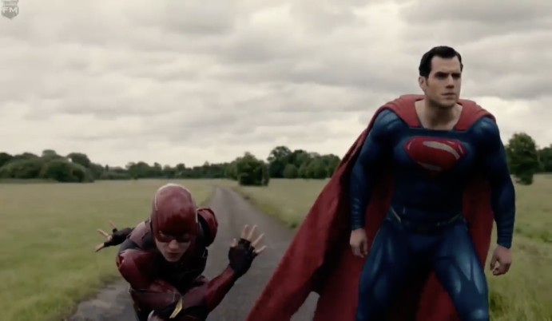
5.8.2 Guided Instruction: The Flash vs. Superman
The Flash challenges Superman to a race. Who do you think will win?
Without watching the race, answer the following.
How can we find out the distance they covered?
volume 1, pg. 247

Slide 9
How can we find out who won?
volume 1, pg. 247

Slide 10
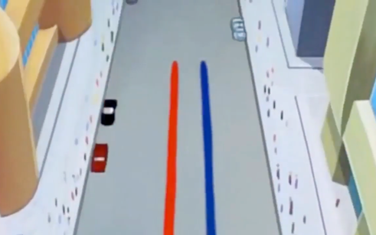
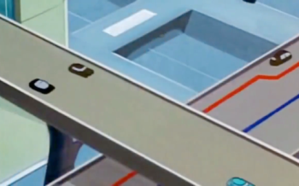
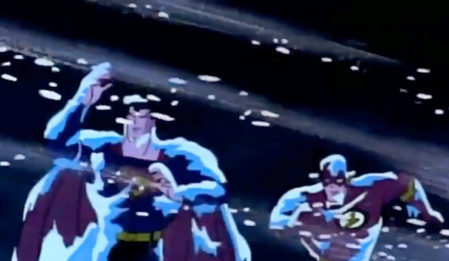
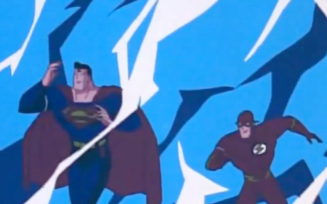
Unfortunately, in the movie, Justice League, we were not able to see who wins. However, the Flash and Superman did race each other in the cartoon and comics version.
They raced through cities…
and on
highways…
and through all kinds of
conditions.
volume 1, pg. 248

Slide 11
What do you see from the comic that is related to determining distance?
volume 1, pg. 248

Slide 12

Exploration
volume 1, pg. 248

Slide 13

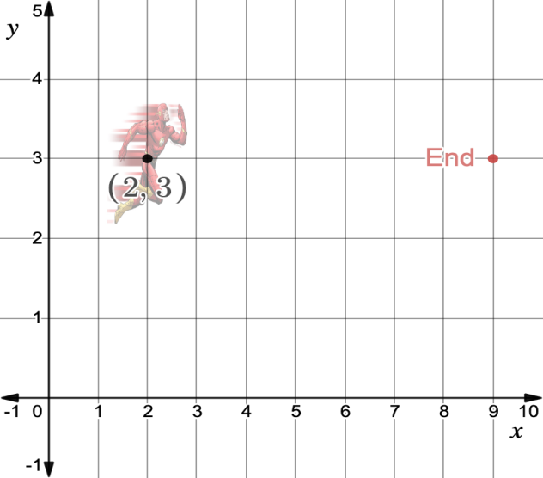

5.8.3 Exploration: Looking at a Trajectory
The following graph shows the Flash running from point $(2, 3)$.
What are the coordinates for where he ends?
volume 1, pg. 248

Slide 14
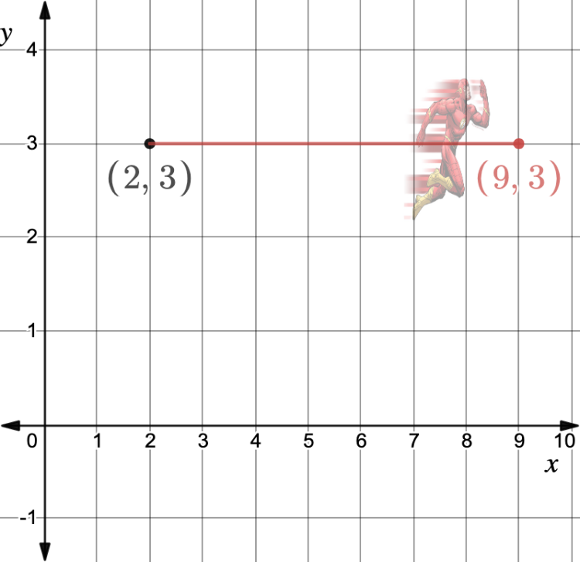
Consider the following graph.
volume 1, pg. 248

Slide 15
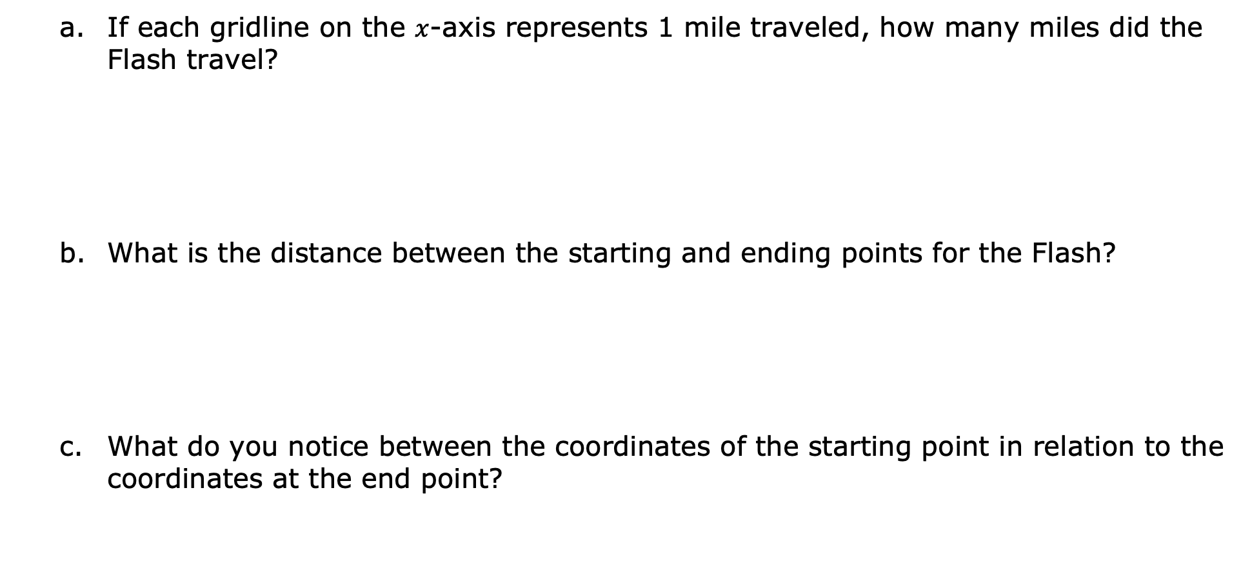
If each gridline on the $x$-axis represents 1 mile traveled, how many miles did the Flash travel?
What is the distance between the starting and ending points for the Flash?
What do you notice between the coordinates of the starting point in relation to the coordinates at the end point?
volume 1, pg. 249

Slide 16
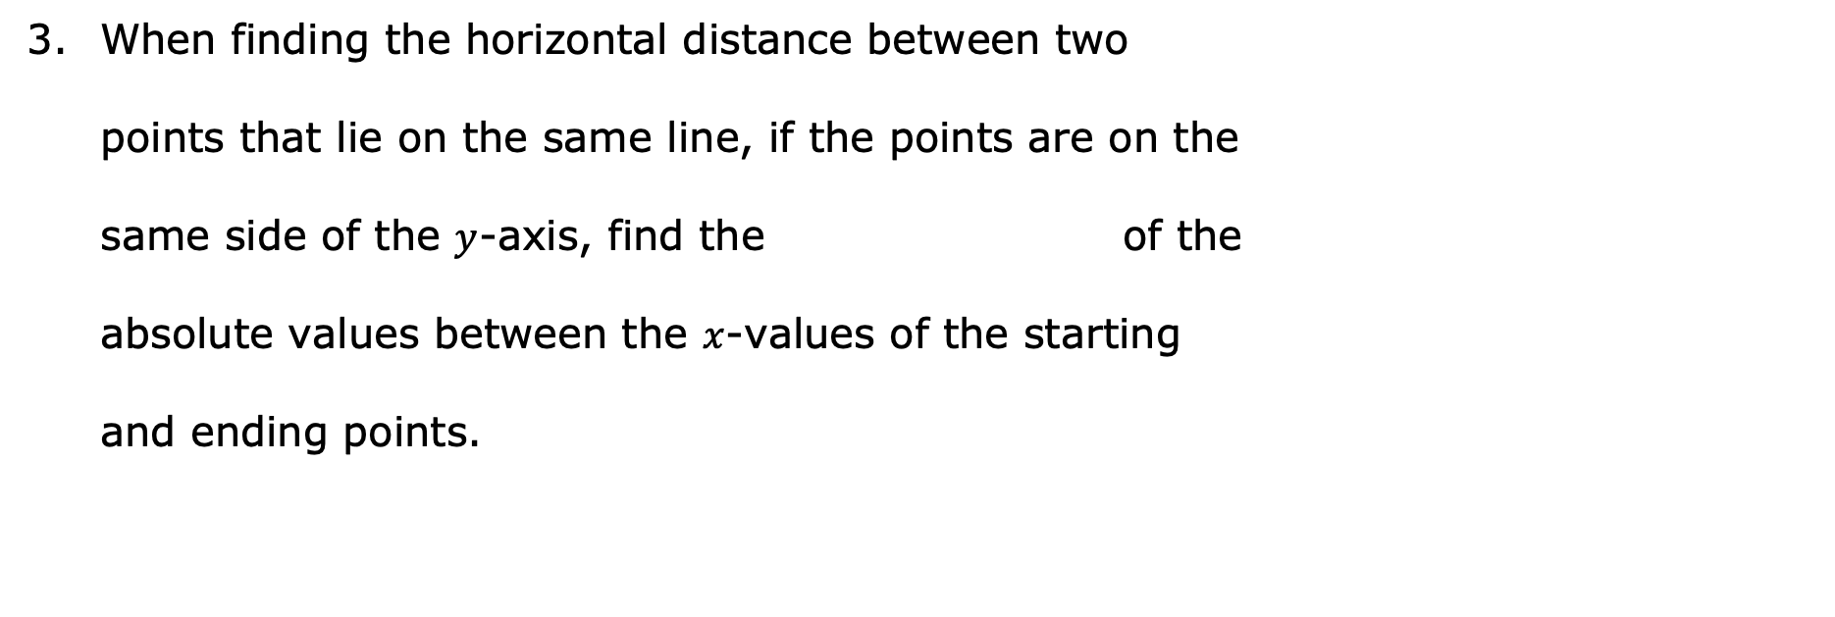
When finding the horizontal distance between two
points that lie on the same line, if the points are on the
same side of the $y$-axis, find the of the
absolute values between the $x$-values of the starting
and ending points.
sum
difference
volume 1, pg. 249

Slide 17
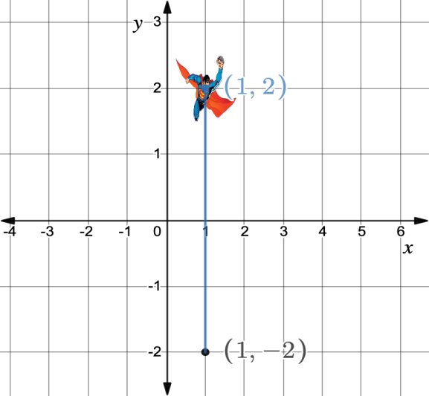

In the graph below, Superman starts flying at point $(1, −2)$. The $y$-axis represents the miles Superman travels.
How many miles does he need to travel to get to point $(1, 2)$?
volume 1, pg. 249

Slide 18
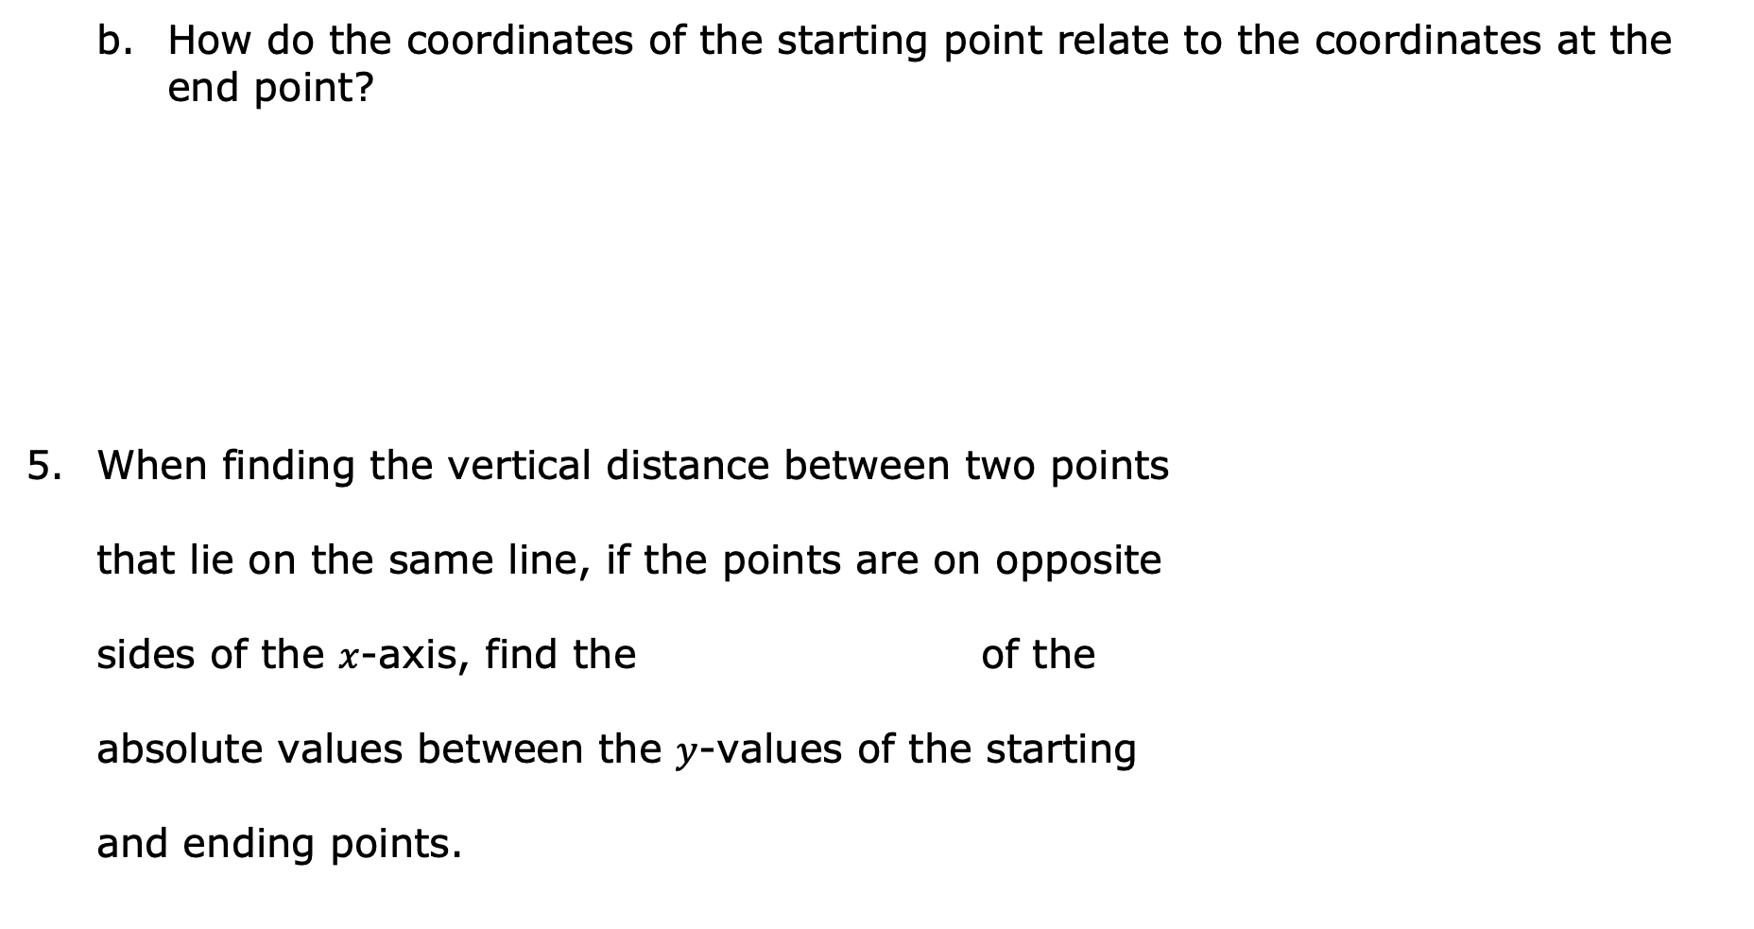
How do the coordinates of the starting point relate to the coordinates at the end point?
When finding the vertical distance between two points
that lie on the same line, if the points are on opposite
sides of the $x$-axis, find the of the
absolute values between the $y$-values of the starting
and ending points.
sum
difference
volume 1, pg. 249

Slide 19
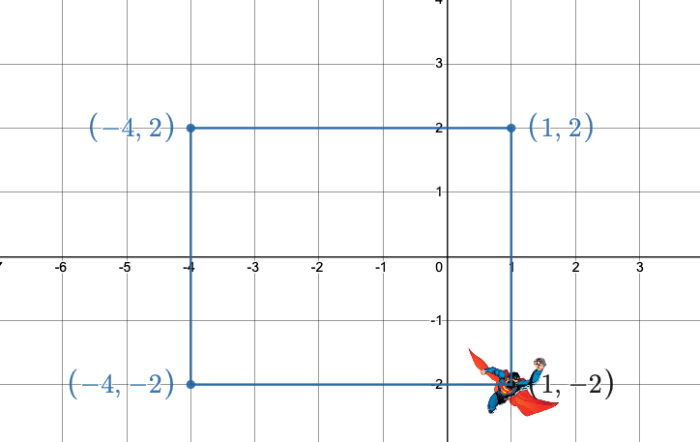

Consider the graph below.
The blue line shows the trajectory Superman followed starting from $(1,−2)$. Assuming the $x$- and $y$-axes represent miles traveled, explain how to determine the distance.
volume 1, pg. 250

Slide 20
What is the total distance traveled by Superman?
volume 1, pg. 250

Slide 21

Guided Practice
volume 1, pg. 250

Slide 22

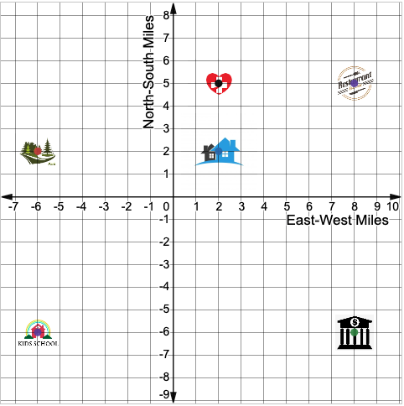
5.8.4 Guided Practice: Town Map on a Coordinate Plane
Consider the following graph.
volume 1, pg. 250

Slide 23
What are the coordinates of the following places in town?
Park (A): ________
School (B): ________
Hospital (C): ________
House (D): ________
Bank (E): ________
Restaurant (F): ________
volume 1, pg. 250

Slide 24
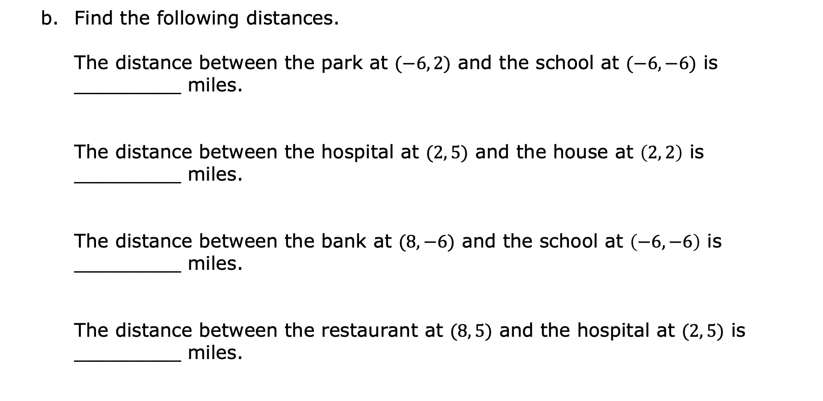
Find the following distances.
The distance between the park at $(−6, 2)$ and the school at $(−6, −6)$ is _________ miles.
The distance between the hospital at $(2, 5)$ and the house at $\left(2, 2\right)$ is _________ miles.
The distance between the bank at $(8, −6)$ and the school at $\left(−6, −6\right)$ is _________ miles.
The distance between the restaurant at $(8, 5)$ and the hospital at $(2, 5)$ is _________ miles.
volume 1, pg. 251

Slide 25
Loki leaves his house and heads towards the park. Then, he goes to school.
What distance has Loki travelled?
Loki gets out of school and goes to the bank to make a few transactions. Then, he heads toward the restaurant to have dinner. What distance has Loki traveled so far?
volume 1, pg. 251

Slide 26
Before going home, Loki needs to stop at the hospital to visit a friend. After leaving the hospital, he finally goes home.
What distance did Loki travel altogether?
volume 1, pg. 251

Slide 27
The city commissioner will build a stadium so that it forms a square with the house, the park, and the school.
Explain where the stadium should be located.
volume 1, pg. 252

Slide 28
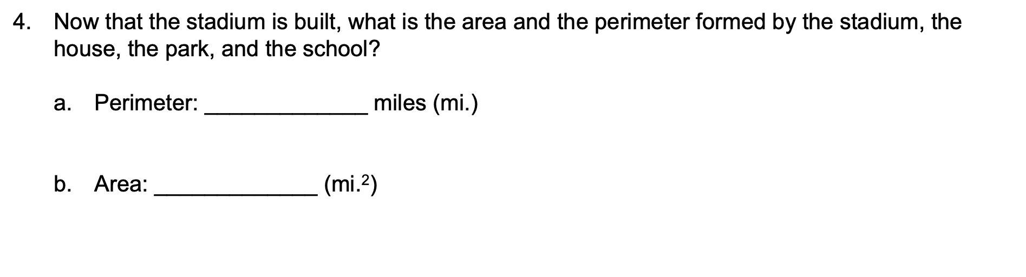
Now that the stadium is built, what is the area and the perimeter formed by the stadium, the house, the park, and the school?
Perimeter: _____________ miles (mi.)
Area: _____________ (mi.²)
volume 1, pg. 252

Slide 29

Your Turn
volume 1, pg. 252

Slide 30
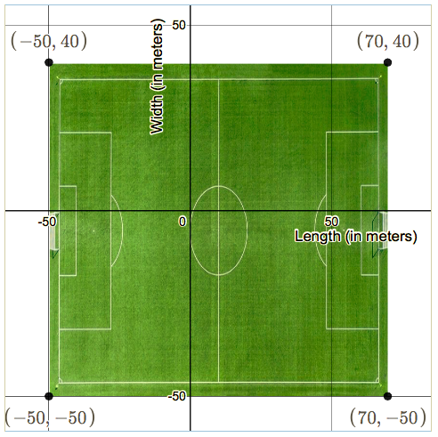
5.8.5 Your Turn!
Consider the soccer field on the coordinate plane.
Find the dimensions of the soccer field.
Length (horizontal): ______________meters (m)
Width (vertical): ______________m
volume 1, pg. 252

Slide 31
What is the perimeter, in meters, of the soccer field?
What is the area, in square meters, of the soccer field?
volume 1, pg. 252

Slide 32

Wrap-Up
volume 1, pg. 253

Slide 33
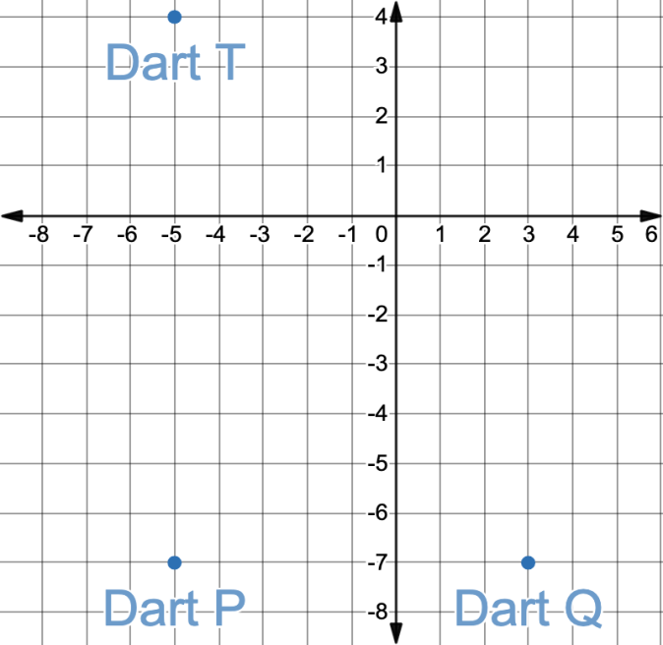
5.8.6 Wrap-Up: Ticket Out the Door
Zander is a competitive dart player. The graph shows a record of his last three darts.
Plot the dart, Dart Z, where Zander should throw his next dart so that it forms a rectangle with the other three on the plane.
volume 1, pg. 253

Slide 34

What is the perimeter of the rectangle formed by the darts?
What is the area of the rectangle formed by the darts?
Zander will take back Darts P and Q. He wants to throw them so that they land on two points, forming a square with Darts T and Z. Where should the Darts P and Q land?
volume 1, pg. 253

